Slide 1

Forecasting Unemployment Trends in Alaska: A Comprehensive Analysis
This project focuses on forecasting unemployment trends in Alaska, a critical economic indicator with significant implications for policy making and resource allocation.
Presenter: Meng Meng
NetID: mm3034
Notes:
Hello everyone. Today I'll be presenting our comprehensive analysis on forecasting unemployment trends in Alaska. My name is MengMeng. The study focuses on predicting and understanding unemployment patterns in Alaska, a critical economic indicator with significant implications for policy making and resource allocation. The analysis combines multiple forecasting approaches to help stakeholders make informed decisions about resource allocation, economic planning, and social service preparation. The insights we've gained can help identify potential economic distress periods and prepare appropriate responses.

Slide 2


Project Overview
Purpose
Importance
Enable better economic planning and resource allocation at state and local levels.
Identify potential economic distress periods and prepare social services effectively.
Notes:
The purpose of this research is twofold. First, we aim to enable better economic planning and resource allocation at both state and local levels in Alaska. The pie chart on the left represents how different economic sectors interact and influence resource allocation decisions.
Second, and equally important, our work helps identify potential economic distress periods, allowing organizations to prepare social services more effectively. This forecasting capability is particularly crucial for Alaska's unique economic landscape, where seasonal variations and external economic factors can significantly impact employment patterns.

Slide 3
Data Description
1
Time Range
Dataset spans from 1976 to 2022, providing monthly observations.
2
Key Metrics
Includes population, labor force, employment, and unemployment numbers and percentages.
3
Scope
Covers all U.S. states, with specific focus on Alaska.
Notes:
Our analysis is built on a robust dataset with three key characteristics:
First, the time range spans from 1976 to 2022, providing monthly observations. This extensive historical data allows us to capture multiple economic cycles, seasonal patterns, and long-term trends.
Second, our key metrics include several critical indicators:
Total Civilian Non-Institutional Population
Total Civilian Labor Force
Employment and Unemployment numbers
Various percentage metrics including labor force participation, employment rate, and unemployment rate
Finally, while the dataset covers all U.S. states, we've focused specifically on Alaska. This focused approach allows us to account for Alaska's unique economic characteristics and seasonal patterns.
The data was collected by the Bureau of Labor Statistics using various methods including Current Population Survey, state cooperation, and administrative data, ensuring high reliability and consistency in our analysis.

Slide 4
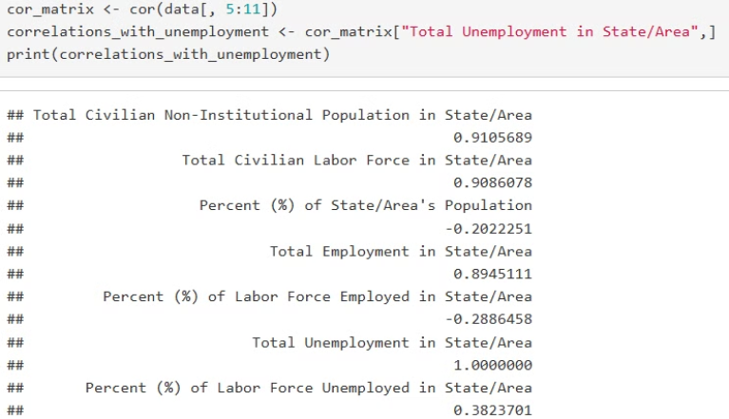
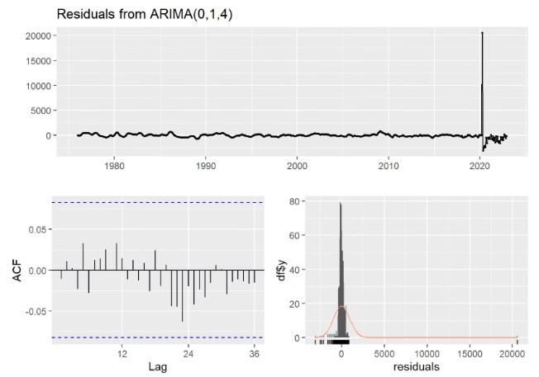
Exploratory Data Analysis Insights
Population-Unemployment Correlation
Structural Breaks
Strong correlation (0.91) between Total Civilian Non-Institutional Population and Total Unemployment.
Notable breaks during 2021-2022, coinciding with the COVID-19 pandemic.
Notes:
Our exploratory data analysis revealed two key findings that significantly influenced our modeling approach:
Looking at the correlation analysis shown on the left, we discovered a remarkably strong correlation of 0.91 between Total Civilian Non-Institutional Population and Total Unemployment. This correlation, identified through our detailed statistical analysis, suggests that population changes could be a valuable predictor of unemployment trends.
On the right, we see the residual analysis from our ARIMA model, which highlights notable structural breaks during 2021-2022. These breaks coincide with the COVID-19 pandemic, showing unprecedented patterns in unemployment data. This observation was crucial in helping us understand the limitations of our models and the need for special consideration of the pandemic period.
The visualizations clearly demonstrate both the strong population-unemployment relationship and the impact of external shocks on our forecasting capabilities.

Slide 5
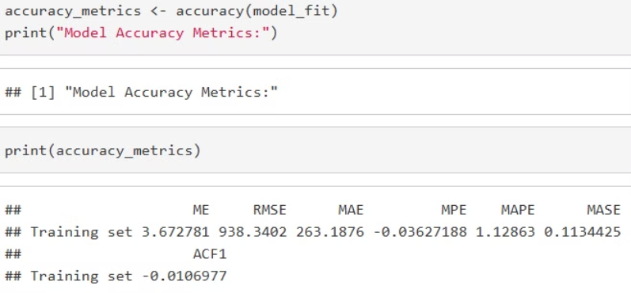
Accuracy Measure Selection
Primary Measure
Advantages
Sensitivity
Mean Square Error (MSE) chosen as the key accuracy measure.
Penalizes larger errors more heavily, suitable for unemployment data.
Appropriately sensitive to outliers in unemployment data.
Other Metrics Used
Mean Error (ME), Root Mean Square Error (RMSE), Mean Absolute Error (MAE), Mean Percentage Error (MPE), and Mean Absolute Percentage Error (MAPE)
Notes:
For our analysis, we employed multiple accuracy measures to ensure robust model evaluation:
Our primary measure is Mean Square Error (MSE), chosen specifically because it penalizes larger errors more heavily. This characteristic is particularly important when forecasting unemployment, where large prediction errors could have significant policy implications.
The advantages of MSE include its sensitivity to outliers and its ability to provide clear numerical comparisons between different models. This sensitivity is crucial for unemployment data, which can show significant variations.
As shown in the code output at the bottom of the slide, we also utilized additional metrics including:
Mean Error (ME): 3.67
RMSE: 938.34
MAE: 263.19
MPE: -0.036
MAPE: 1.13%
MASE: 0.113
ACF1: -0.0107
These multiple metrics give us a comprehensive view of model performance across different dimensions.

Slide 6





Forecasting Methods and Residual Analysis
ARIMA Model
ARIMA(0,1,4) identified as optimal, with significant MA components.
Moving Average
MA(12) effective in smoothing short-term fluctuations.
Holt-Winters Method
Incorporated trend and seasonal components, effective for percentage-based metrics.
Naive methods
served as important baseline comparisons and showed surprising effectiveness for labor force predictions
Exponential Smoothing
demonstrated good adaptive capability to changing trends and balanced historical data with recent observations
Notes:
Let me walk you through both our forecasting methods and their detailed residual analysis:
First, our ARIMA(0,1,4) model showed significant Moving Average components. The residual analysis for this model was particularly revealing:
The Ljung-Box test yielded a p-value of 0.9832, strongly indicating independently distributed residuals
We found virtually no remaining autocorrelation, with an ACF1 value of -0.0107
The residual pattern showed homoscedasticity in pre-2020 periods
For our Moving Average model, particularly MA(12):
It effectively smoothed short-term fluctuations
The residuals showed consistent variance across most of the time series
However, we noticed increased volatility during economic shock periods
The Holt-Winters method's residual analysis revealed:
Strong handling of seasonal patterns
Some heteroscedasticity in the error terms
Better performance with percentage-based metrics
Naive methods showed interesting residual patterns:
Larger errors during volatile periods
Surprisingly small residuals for labor force predictions
Clear seasonal patterns in the residuals
Finally, Exponential Smoothing demonstrated:
Adaptive capability to changing trends
Generally well-behaved residuals
Some autocorrelation at seasonal lags
The residual analysis was crucial in identifying model limitations, particularly during the COVID-19 period where all models showed larger than normal residuals, indicating a structural break in the time series. This led us to recommend separate modeling approaches for different time periods.

Slide 7



Prediction Results and Accuracy
ARIMA
Holt-Winters
Naive Method
Best performer with minimum auto-correlation in residuals.
Strongest in forecasting Population Percentage metrics.
Most effective for Labor Force predictions.
Notes:
Let's examine how each model performed in terms of prediction accuracy:
The ARIMA model emerged as our best overall performer, showing:
Minimum autocorrelation in residuals (ACF1: -0.0107)
Strong performance metrics with ME of 3.67 and RMSE of 938.34
Most reliable overall predictions for general unemployment trends
The Holt-Winters method showed particular strength in forecasting Population Percentage metrics:
Achieved the lowest MSE (0.030) for population percentage predictions
Demonstrated superior handling of seasonal variations
Particularly effective for long-term trend predictions
The Naive method, interestingly, proved most effective for Labor Force predictions:
Achieved best MSE (491,136) for labor force forecasts
Provided surprisingly accurate short-term predictions
Served as an effective baseline for other models
These results underscore the importance of using different models for different aspects of unemployment forecasting.

Slide 8
Model Performance Analysis
Complex Models
1
ARIMA and Holt-Winters provided better overall stability and reliability. Especially ARIMA has the lowest auto-correlation in residuals.
Simple Models
2
MA5 often performed best for specific metrics.
COVID-19 Impact
3
Models struggled with structural break during the pandemic period.
Notes:
Our model performance analysis revealed three key findings:
First, regarding complex models, ARIMA and Holt-Winters provided better overall stability and reliability. The ARIMA model, in particular, showed the lowest auto-correlation in residuals, making it our most reliable predictor for general trends.
Second, looking at simple models, MA5 often outperformed more complex approaches for specific metrics. For example:
Total Employment (MSE: 2,246,929)
Employment Rate (MSE: 0.246)
Total Unemployment (MSE: 10,152,643)
Third, and critically important, we observed significant COVID-19 impact across all models. During the pandemic period, we saw structural breaks that challenged all our forecasting approaches, suggesting the need for separate modeling strategies for this period.

Slide 9
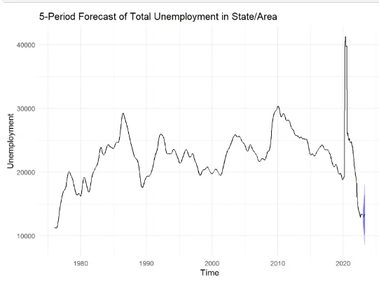
Analysis-Based Decision
±938
Confidence Interval
95% confidence range for unemployment levels from ARIMA model.
20K-22K
Unemployment Forecast
Short-term prediction range for unemployed individuals in Alaska.
Notes:
Based on our comprehensive analysis, we can make several key predictions about Alaska's unemployment trends:
Looking at our confidence intervals, the ARIMA model suggests a ±938 range around our predictions, giving us a 95% confidence level in our forecasts.
For the short-term unemployment forecast, we're predicting a range of 20,000-22,000 unemployed individuals in Alaska. This forecast takes into account:
Recent trend patterns shown in the graph
Seasonal variations typical for Alaska
Historical pattern analysis
Model performance metrics
The graph clearly shows the historical unemployment patterns and our forecast range, with the notable spike during the COVID-19 period providing important context for our predictions.

Slide 10




Recommendations for Improvement
External Indicators
1
Incorporate GDP, inflation rates, and regional economic factors.
Separate Models
2
Develop models for pre- and post-COVID periods.
Ensemble Methods
3
Combine multiple forecasting approaches for improved accuracy.
Intervention Analysis
4
Include analysis for significant events and seasonal adjustments.
Notes:
Finally, let me present our key recommendations for improving future forecasting accuracy. We've organized these into four critical areas:
First, regarding External Indicators, we strongly recommend incorporating additional economic factors:
GDP data for Alaska
State-specific inflation rates
Regional economic indicators
Industry-specific factors unique to Alaska's economy These additional data points would provide crucial context for our predictions.
Second, we propose developing Separate Models for different time periods:
Pre-COVID models to capture normal economic patterns
Post-COVID models to account for new economic realities
This split approach would help address the structural breaks we identified in our analysis
Third, we recommend implementing Ensemble Methods:
Combining predictions from multiple models
Weighted averaging based on model performance
This would help leverage the strengths of each forecasting approach
Could potentially improve our current accuracy levels
Fourth, we suggest including Intervention Analysis:
Accounting for significant economic events
Developing Alaska-specific seasonal adjustments
Incorporating known policy changes
This would help capture the unique aspects of Alaska's economy
These recommendations, if implemented, could significantly improve the accuracy and reliability of our unemployment forecasts. They address the key limitations we discovered in our current approach while building on our successful methodologies.
Thank you for your attention. Are there any questions about our analysis or recommendations?

